Slide 1

Final Year Project, Gym Personal Training & Analytics App
Student Name : Daniel Murphy
Student No. : C00247818
Supervisor : Greg Doyle

Slide 2
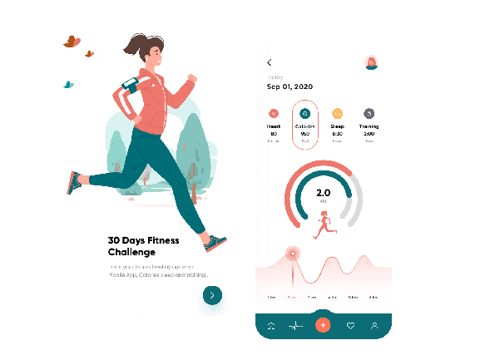

Introduction To The Project
The main purpose of this project is to create a cross platform application which will enable personal trainers or coaches to interact with their clients or players via mobile.
Purpose of the project.
Different Technologies researched.
The overall progress of the project up to date.
Questions?

Slide 3


Description Of The Project
This application is not just aimed at personal trainers but for coaches of sports teams with many players to manage.
Ability to provide clients with a full workout or nutrition plan.
Trainer adds a client - client receives link to sign up.
Users can fully customize their own workout or nutrition plan.
Analysis for user input on weights / reps to provide feedback.
Image / Video Analysis to provide feedback on users form.
Trainer account type will cost per month. User account is free with options for paid advanced plans.

Slide 4





Overview of Different Technologies
Frontend Technologies:
React Native / Expo
Flutter
Ionic
Figma
Backend / Database Technologies
Django
Flask
Firebase
Heroku
Machine Learning Technologies:
Pandas
TensorFlow
Keras
Scikit Learn
PyTorch

Slide 5


The Projects Current Progress
Frontend Technology - React Native.
Expo - Toolkit for developing applications quick. Easy development environment
Figma for designs.
Simple login screen with Django / Firebase.
Possible problems using android studio.
Backend / Database Technologies - Django / Firebase
Django caters for specific needs - allows for complete building of backend server.
Firebase is a Backend-as-a-Service. Less specific to project.
Firebase saves time as no backend code needed.
Machine Learning Technologies - Pandas / TensorFlow / Scikit Learn
Pandas used to get the data into a dataframe.
TensorFlow - uses Keras for training the model.
More research needed on how to implement.

Slide 6
Questions?

Slide 7
Bibliography
Acharya, N. (2021). Top 8 Reasons Why Custom Web Application Development Should be the Focus of Your Business. [online] Cloud Data Analytics Company. Available at: https://www.anblicks.com/blog/why-custom-web-application-development-should-be-the-focus-of-your-business/ [Accessed 23 Nov. 2022].
Sep 2020, 4184 V. and Correspondent, 08:17 Pmt. (n.d.). 5 Programming project ideas for beginner software developers. [online] TechGig. Available at: https://content.techgig.com/technology/5-programming-project-ideas-for-beginner-software-developers/articleshow/77964118.cms [Accessed 23 Nov. 2022].
appmaster.io. (n.d.). How to Build a Fitness App and Get Success | AppMaster. [online] Available at: https://appmaster.io/blog/how-build-fitness-app-and-get-success [Accessed 23 Nov. 2022].
CityPNG | Download FREE HD PNG Images. (n.d.). Loading Load Icon Transparent PNG. [online] Available at: https://www.citypng.com/photo/20701/loading-load-icon-transparent-png [Accessed 23 Nov. 2022].
AppCoda. (n.d.). Introduction to React Native: Building iOS Apps with JavaScript. [online] Available at: https://www.appcoda.com/react-native-introduction/. [Accessed 23 Nov. 2022]
Samsukha, A. (2020). Health & Fitness Mobile App Development: Cost & Features. [online] Tech Blog | Mobile App, eCommerce, Salesforce Insights. Available at: https://www.emizentech.com/blog/health-fitness-mobile-app-development.html. [Accessed 23 Nov. 2022]
Mahale, V. (2022). Product Interview: (Hypothetical) Figma is losing customers at 6–7% weekly. Figure out the reason &. [online] Medium. Available at: https://bootcamp.uxdesign.cc/product-interview-rca-solution-design-question-figma-is-losing-customers-at-6-7-weekly-a9c1eb11a236 [Accessed 23 Nov. 2022].
www.pngwing.com. (n.d.). Django png images | PNGWing. [online] Available at: https://www.pngwing.com/en/search?q=django [Accessed 23 Nov. 2022].
www.wuzshop.com. (n.d.). www.wuzshop.com. [online] Available at: https://www.wuzshop.com/?category_id=2730310 [Accessed 23 Nov. 2022].
Begoon, T. combined, edited- (2018). TensorFlow logo. [online] Wikimedia Commons. Available at: https://commons.wikimedia.org/wiki/File:TensorFlowLogo.svg [Accessed 23 Nov. 2022].

